Slide 1

Stock AI Assistant 3nd Hons Meeting Finn Zhan Chen – 11th February 2019 Supervised by Shay Cohen

Slide 2
Project Overview
Major Change (Bad news…)
Shift from cloud to local computing
No mobile apps
No enough easily accessible fundamental analysis
Major Change (Good news!)
Focus narrowed to only technical analysis
Now model uses real-time technical indicators to predict stock price in the past (testing purpose), present (tomorrow), and future (multiple days in advance)
Evaluation infrastructure is set up

Slide 3
Current Progress: Summary
LSTM Training and Testing Data Preparation
Transform the time series data so that it is stationary.
Transform the observations to have a specific scale.
Transform the time series into a supervised learning problem
Univariate Models
Persistence baseline models for univariate one-step and multi-step forecasting
LSTM one-step forecasting (predicting stock price for one day in advance)
LSTM multi-step forecasting (predicting stock price for more than one day in advance)
Model Evaluation
Mean squared error
Trend accuracy (tomorrow’s price is predicted to be up and the actual price is up too, thus the trend is correct)

Slide 4
Current Progress: Achieved
LSTM Training and Testing Data Preparation
1. Raw price data
2018-01-02 43.67
2018-01-03 44.98
2018-01-04 46.88
2018-01-05 45.80
2018-01-08 45.55
2018-01-09 42.97
2018-01-10 43.31
2. Transform the time series data so that it is stationary by differencing.
[ 1.31],
[ 1.9 ],
[-1.08],
[-0.25],
[-2.58],
[ 0.34]
3 Transform the observations to have a specific scale.
[ 0.73660714]
[ 1. ]
[-0.33035714]
[ 0.04017857]
[-1. ]
[ 0.30357143]
4 Transform the time series into a supervised learning problem
var1(t-1) var1(t)
1 0.736607 1.000000
2 1.000000 -0.330357
3 -0.330357 0.040179
4 0.040179 -1.000000
5 -1.000000 0.303571

Slide 5
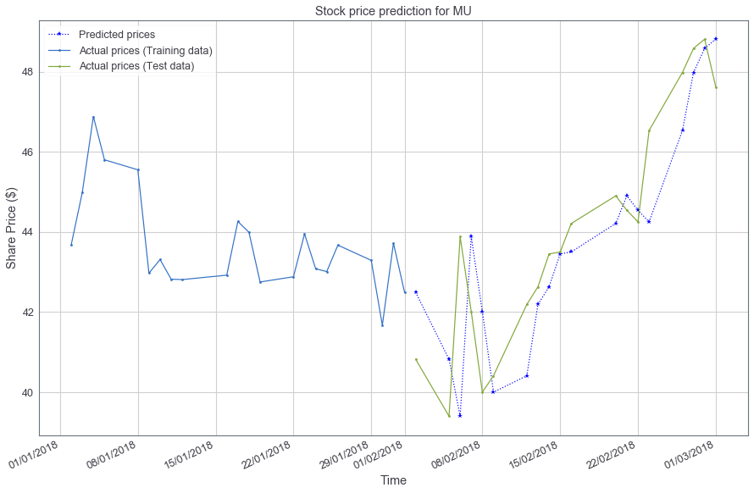
Current Progress: Achieved
Univariate 1-step Baseline (a quick example)
LSTM RMSE Score: 1.572 US dollar
LSTM trend Score: 0 %

Slide 6
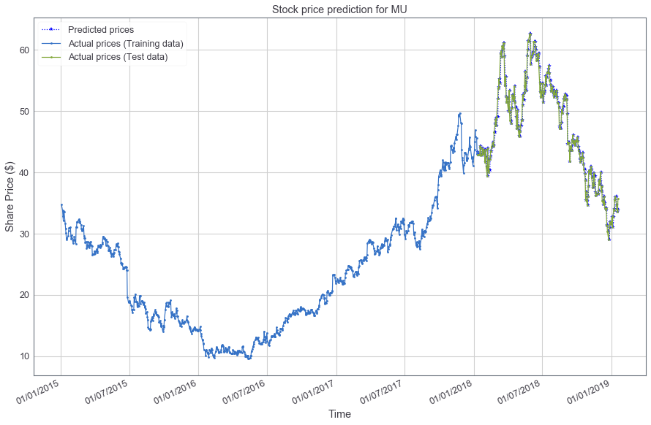
Current Progress: Achieved
Univariate 1-step Baseline (more data)
LSTM RMSE Score: 1.443 US dollar
LSTM trend Score: 0%

Slide 7
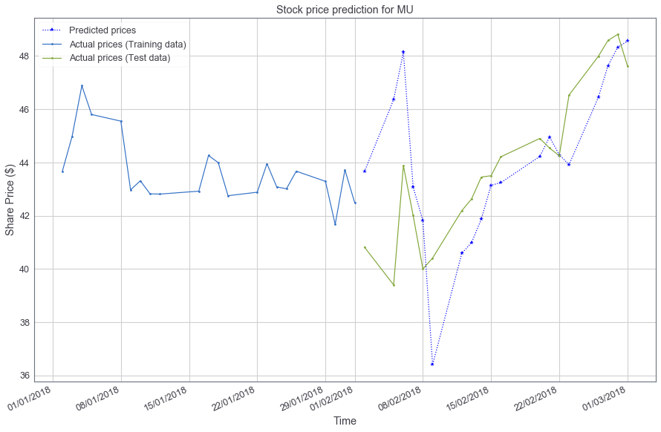
Current Progress: Achieved
Univariate 1-step Forecasting (a quick example)
LSTM RMSE Score: 2.468 US dollar
LSTM trend Score: 36.8 %
Took 74 seconds to train!

Slide 8

Current Progress: Achieved
Univariate 1-step Forecasting (more training data)
LSTM RMSE Score: 1.459 US dollar
LSTM trend Score: 51.0 %
Took 1 hour to train…

Slide 9
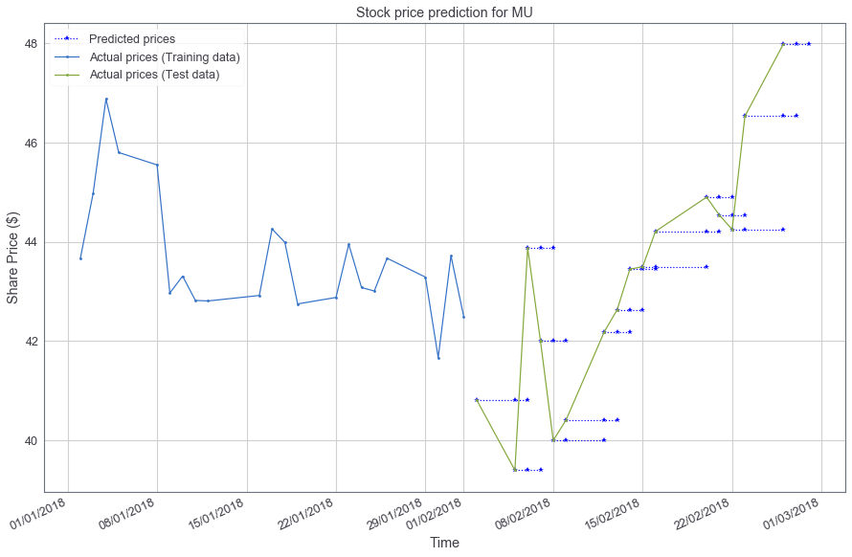
Current Progress: Achieved
Univariate 3-step Baseline (a quick example)
RMSE: t+1: 5.095, t+2: 4.266, t+3: 6.202 US dollar
Trend Score: t+1: 31.5%, t+2: 31.5% , t+3: 42.1%
Took 72 second to train!

Slide 10
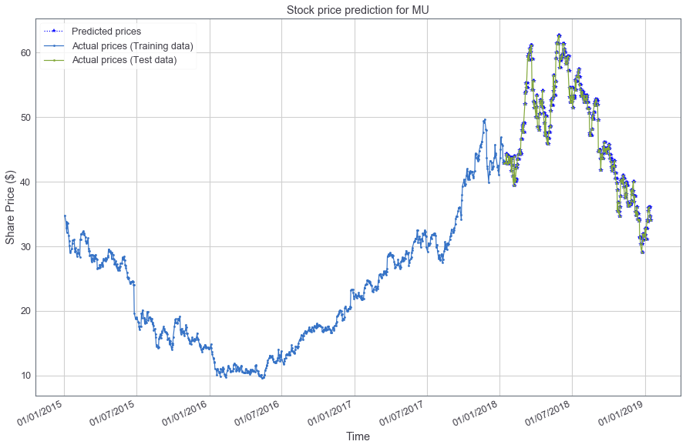
Current Progress: Achieved
Univariate 3-step Baseline (more training data)
RMSE: t+1: 1.446, t+2: 1.775, t+3: 2.047 US dollar
Trend Score: t+1: 0% , t+2: 0% , t+3: 0%

Slide 11
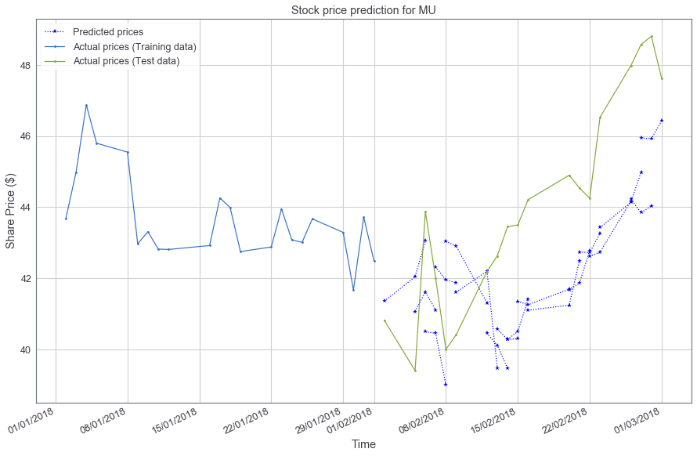
Current Progress: Achieved
Univariate 3-step Forecasting (a quick example)
RMSE: t+1: 5.095, t+2: 4.266, t+3: 6.202 US dollar
Trend Score: t+1: 31.5%, t+2: 31.5% , t+3: 42.1%
Took 72 second to train!

Slide 12
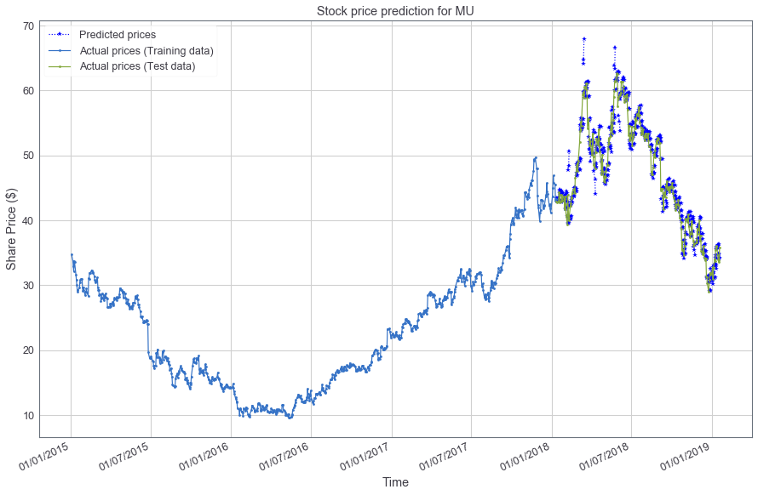
Current Progress: Achieved
Univariate 3-step Forecasting (more training data)
RMSE: t+1: 1.577, t+2: 2.174, t+3: 2.740 US dollar
Trend Score: t+1: 48.6%, t+2: 49.4% , t+3: 52.1%
Took 1 hour to train…

Slide 13
Current Progress: Next Steps
Evaluation
Compare to baseline models like Persistence Model Forecast
Training, validation, and testing set
Parameter optimisation
Multivariate One-step and Multi-step forecasting
Training data not only just include share price data but also other additional 52 indicators such as SMA,
Also not just price of the day prior but multiple steps prior

Slide 14
Gantt Chart
Timeline
Data source mining
Sep
Research & Reading
Oct
System Design
Nov
Development
Dec-Mar
Interim Write-up
Jan
Visualisation
Feb-Mar
Final Write-up
Mar-Apr
Submission
(4 Apr 2019)
Start
Semester 1
Semester 2

